Slide 1
Classes (3)
Lecture 8

Slide 2
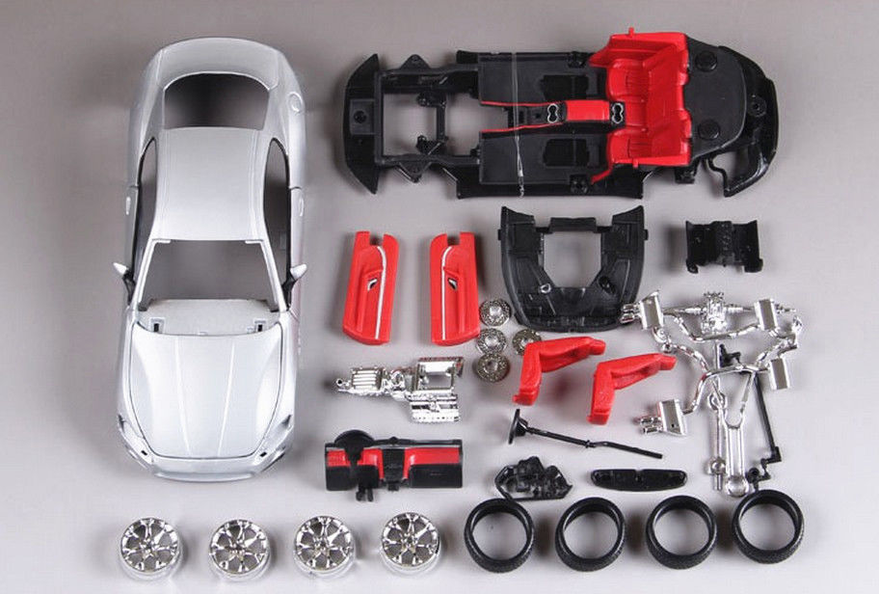
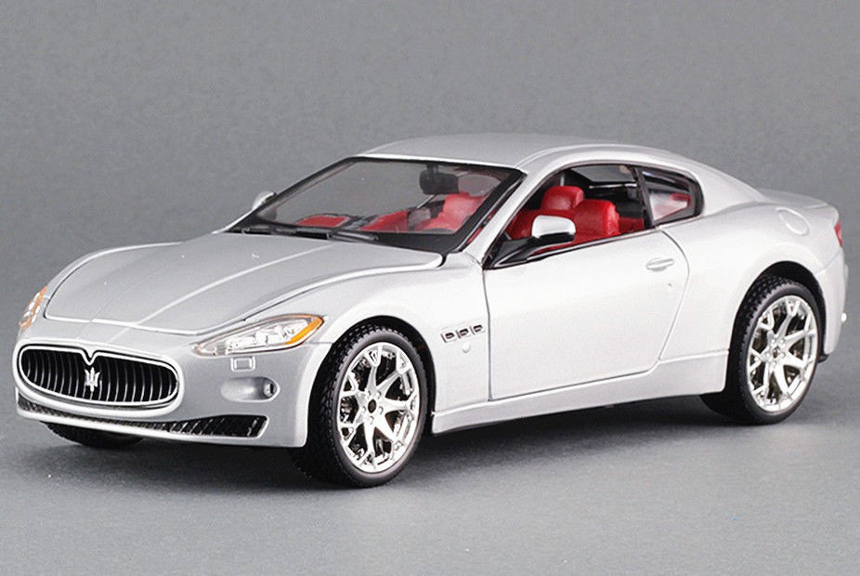
OOP
The key ideas in OOP are data abstraction, inheritance, and dynamic binding.
Abstraction 抽象 / encapsulation 封装
向用户展示其所需要了解的重要信息，隐藏其所不必要了解的实现细节
踩油门加速
踩刹车减速
转动方向盘改变方向
封装
抽象
颜色、款式、舒适性
…
Images from https://www.ebay.com/itm/Bburago-1-24-Maserati-GT-Diecast-Assembly-KIT-Model-Car-Vehicle-Toy-/282838475820 [Nov 26, 2018]

Slide 3
OOP
The key ideas in OOP are data abstraction, inheritance, and dynamic binding.
Inheritance 继承：令新的对象得以使用既有对象的属性
Images from https://www.python-course.eu/python3_inheritance.php [Nov 26, 2018]

Slide 4
OOP
The key ideas in OOP are data abstraction, inheritance, and dynamic binding.
Dynamic binding 动态绑定：在运行时才决定运行哪一段代码
int Bike::go( ) { 步行; }
int PedalBike::go( ) { 踩脚踏板; }
int MotorBike::go( ) {
转动车把手;
}

Slide 5


Base & derived classes
设计一个Quote类，包含书的ISBN和price数据，要求实现isbn函数用于获取书的ISBN，并实现net_price函数，返回$n$本书的总价。
另外，设计一个Bulk_quote类，其中也包含书的ISBN和price数据，也要求实现isbn函数用于获取书的ISBN以及net_price函数用于计算$n$本书的总价，但在计算总价时，当购买数量不小于某个最低数量min_qty时，可以按折扣率discount打折。

Slide 6
Base & derived classes
class Quote {
public:
Quote( );
~Quote( );
string isbn( ) const;
double net_price(size_t) const;
private:
string bookNo;
double price;
};
class Bulk_quote {
public:
Bulk_quote( );
~Bulk_quote( );
string isbn( ) const;
double net_price(size_t) const;
private:
string bookNo;
double price;
size_t minQty;
double discount;
};
有大量的重复代码
（重复在哪里？）
怎么办？

Slide 7
Base & derived classes
公有继承
class Quote {
public:
Quote( );
virtual ~Quote( );
string isbn( ) const;
virtual double net_price(size_t) const;
private:
string bookNo;
protected:
double price;
};
class Bulk_quote: public Quote {
public:
Bulk_quote( );
virtual ~Bulk_quote( );
virtual double net_price(size_t) const;
private:
size_t min_qty;
double discount;
};
虚函数
保护成员

Slide 8
Base & derived classes
Bulk_quote数据成员
bookNo
price
bookNo
price
继承自Quote的数据成员
min_qty
discount
Bulk_quote追加定义的数据成员
The inheritance models an IS-A relationship: A Bulk_quote is a Quote.
Since a Bulk_quote is a Quote, it is logical and natural that we use a Bulk_quote object as if it were a Quote object (derived-to-base conversion).

Slide 9
IS-A vs HAS-A
Quote
Bike
- bookNo: string
- price: double
- fwheel: Wheel
- rwheel: Wheel
Bulk_quote
Wheel
- min_qty: size_t
- discount: double
- brand: string
[Composition]
A bike has a front wheel.
A bike has a rear wheel.
[Inheritance] A bulk quote is a quote.

Slide 10
Derived-class constructors
class Quote {
public:
Quote( ): bookNo(“unknown”), price(0.0) { }
Quote(const string &isbn, double p): bookNo(isbn), price(p) { }
};
调用Quote的构造函数构造Quote的数据成员
class Bulk_quote: public Quote {
public:
Bulk_quote( ): Quote( ), min_qty(10), discount(1.0) { }
Bulk_quote(const string &isbn, double p, size_t q, double d):
Quote(isbn, p), min_qty(q), discount(d) { }
};

Slide 11
Derived-class constructors
Each class controls how its members are initialized.
The base class is initialized first, and then the members of the derived class are initialized in the order in which they are declared in the class.

Slide 12
Derived-class constructors
1.
Bulk_quote(const string &isbn, double p, size_t q, double d):
Quote(isbn, p), min_qty(q), discount(d) { }
correct
2.
Bulk_quote(const string &isbn, double p, size_t q, double d):
bookNo(isbn), price(p), min_qty(q), discount(d) { }
cannot find non-static members ‘bookNo’ and ‘price’
3.
Bulk_quote(const string &isbn, double p, size_t q, double d): min_qty(q), discount(d) {
bookNo = isbn;
price = p;
}
not recommended even when there’s no error/warning
将尝试调用Quote的默认构造函数

Slide 13
Preventing from inheritance
class Quote final { … };
class Bulk_quote: public Quote { … };
error: class ‘Quote’ is marked ‘final’
class Quote { … };
class Bulk_quote final: public Quote { … };
class Some_other_quote: public Bulk_quote { … };
ok
error: class ‘Bulk_quote’ is marked ‘final’

Slide 14
Static & dynamic types
item的static type是Quote&
void print_total(ostream &os, const Quote &item, size_t n) {
os << item.net_price(n) << endl;
}
注意这里的调用方式，是通过引用来访问Quote类的net_price成员函数
Quote q(“978-0-321-71411-4”, 56.99);
print_total(cout, q, 10);
Bulk_quote bq(“978-0-262-03384-8”, 65.46, 10, 0.85);
print_total(cout, bq, 12);
item的dynamic type是Quote&
569.9
667.692
item的dynamic type是Bulk_quote&

Slide 15
Static & dynamic types
item的static type是Quote*
void print_total(ostream &os, const Quote *item, size_t n) {
os << item->net_price(n) << endl;
// 或 os << (*item).net_price(n) << endl;
}
注意这里的调用方式，是通过指针来访问Quote类的net_price成员函数
Quote *q = new Quote(“978-0-321-71411-4”, 56.99);
print_total(cout, q, 10);
Bulk_quote *bq = new Bulk_quote(“978-0-262-03384-8”, 65.46, 10, 0.85);
print_total(cout, bq, 12);
item的dynamic type是Quote*
569.9
667.692
item的dynamic type是Bulk_quote*

Slide 16
Static & dynamic types
item的static type是Quote*
void print_total(ostream &os, const Quote *item, size_t n) {
Quote q = *item;
os << q.net_price(n) << endl;
}
注意这里的调用方式，是通过对象来访问Quote类的net_price成员函数
Quote *q = new Quote(“978-0-321-71411-4”, 56.99);
print_total(cout, q, 10);
Bulk_quote *bq = new Bulk_quote(“978-0-262-03384-8”, 65.46, 10, 0.85);
print_total(cout, bq, 12);
item的dynamic type是Quote*
569.9
785.52
item的dynamic type是Quote*

Slide 17
(*item).net_price(n);
Quote q = *item;
q.net_price(n);
VS
Why are the results different?
item
0x7ffeee70fac8
q
Quote q = *item;
bookNo
price
bookNo
price
bookNo
price
min_qty
discount
经过（截断）赋值，目标存储位置已经发生了变化
引用和指针的dereference都不改变对象的存储位置

Slide 18
Base-derived type conversions
Base base;
Derived *d_ptr = &base;
Derived &d_ref = base;
error. 派生类指针不能指向基类对象
error. 派生类引用不能绑定基类对象
Derived derived;
Base *b_ptr = &derived;
Derived *d_ptr = b_ptr;
ok. 派生类对象也是基类对象（IS-A）
error. 无法将基类指针转换为派生类指针
[EXERCISE] 结合上一页的图，解释编译器判定上述3种错误的理由。

Slide 19
Virtual functions & polymorphism 多态
class Quote {
public:
virtual double net_price(size_t) const;
};
声明虚函数
要求编译器检查是否真的是override（C++11）
class Bulk_quote: public Quote {
public:
virtual double net_price(size_t) const override;
};
virtual可以不重复写

Slide 20
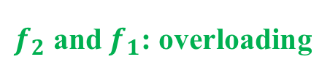
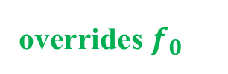
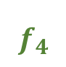

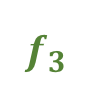
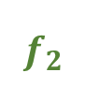
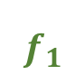
Overloading 重载 vs overriding 覆盖
class Quote {
public:
virtual double net_price(size_t) const;
};
$$f_{0}$$
class Bulk_quote: public Quote {
public:
virtual double net_price(size_t) const override;
double net_price(size_t, size_t) const;
virtual double net_price(size_t*, size_t) const;
virtual double net_price(const vector<size_t>&) const override;
};
$$f_{1}$$
overrides $f_{0}$
$$f_{2}$$
$f_{2}$ and $f_{1}$: overloading
$$f_{3}$$
still overloading
$$f_{4}$$
error. 标记为override但没有override任何函数

Slide 21
Preventing from overriding
class Quote {
public:
virtual double net_price(size_t) const;
};
Quote
Bulk_quote
class Bulk_quote: public Quote {
public:
virtual double net_price(size_t) const override final;
};
Other_quote
class Other_quote: public Bulk_quote {
public:
virtual double net_price(size_t) const override;
};
error.
试图override一个final函数

Slide 22
Implementing virtual functions
在函数（分体式）实现时不需要关键词virtual、override或final，它们用在声明时向编译器提供信息。
double Quote::net_price(size_t n) const { return n * price; }
double Bulk_quote::net_price(size_t n) const {
double ret = n * price;
return n >= min_qty ? ret * discount : ret;
}

Slide 23
Virtual destructors
class Quote {
public:
Quote( );
virtual ~Quote( );
};
bookNo
price
存在继承关系时，析构函数几乎必须是virtual的。
class Bulk_quote: public Quote {
public:
Bulk_quote( );
virtual ~Bulk_quote( );
};
bookNo
price
bookNo
price
min_qty
discount

Slide 24
Circumventing the virtual mechanism
double Quote::net_price(size_t n) const;
double Bulk_quote::net_price(size_t n) const;
Bulk_quote *bq = new Bulk_quote(“978-0-262-03384-8”, 65.46, 10, 0.85);
cout << bq->net_price(12) << endl;
cout << bq->Quote::net_price(12) << endl;
667.692
785.52
如果需要频繁地绕过virtual mechanism（尤其是在外部使用派生类的时候），请检视基类和派生类的设计是否合理。

Slide 25
Abstract base classes
不同的Shape之间没有公共的/基本的面积公式或周长公式
在明确具体的形状（长方形、三角形等等）之前，Shape仅仅是一个抽象概念
尽管如此，我们知道任何具体的Shape都应当能够计算出面积和周长
class Shape {
public:
Shape( ) = default;
virtual ~Shape( );
virtual double area( ) const = 0;
virtual double perimeter( ) const = 0;
};
pure virtual functions (纯虚函数)

Slide 26
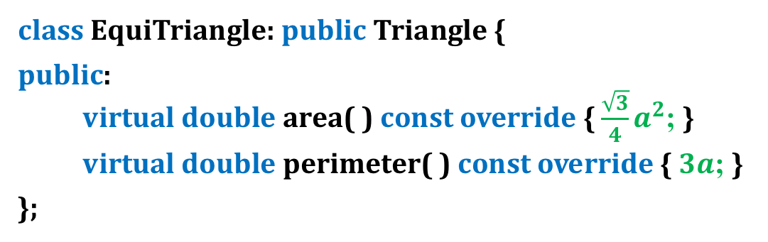
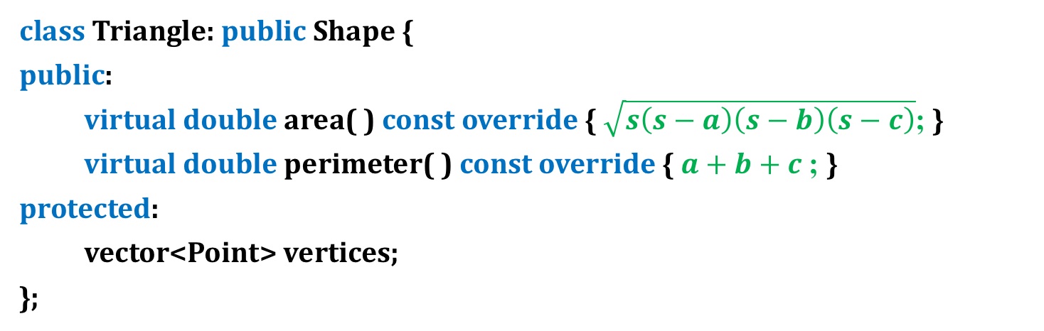
Abstract base classes
class Triangle: public Shape {
public:
virtual double area( ) const override { $\sqrt{s\left(s−a\right)\left(s−b\right)\left(s−c\right)}$; }
virtual double perimeter( ) const override { $a+b+c$; }
protected:
vector<Point> vertices;
};
class EquiTriangle: public Triangle {
public:
virtual double area( ) const override { $\frac{\sqrt{3}}{4}a^{2}$; }
virtual double perimeter( ) const override { $3a$; }
};

Slide 27
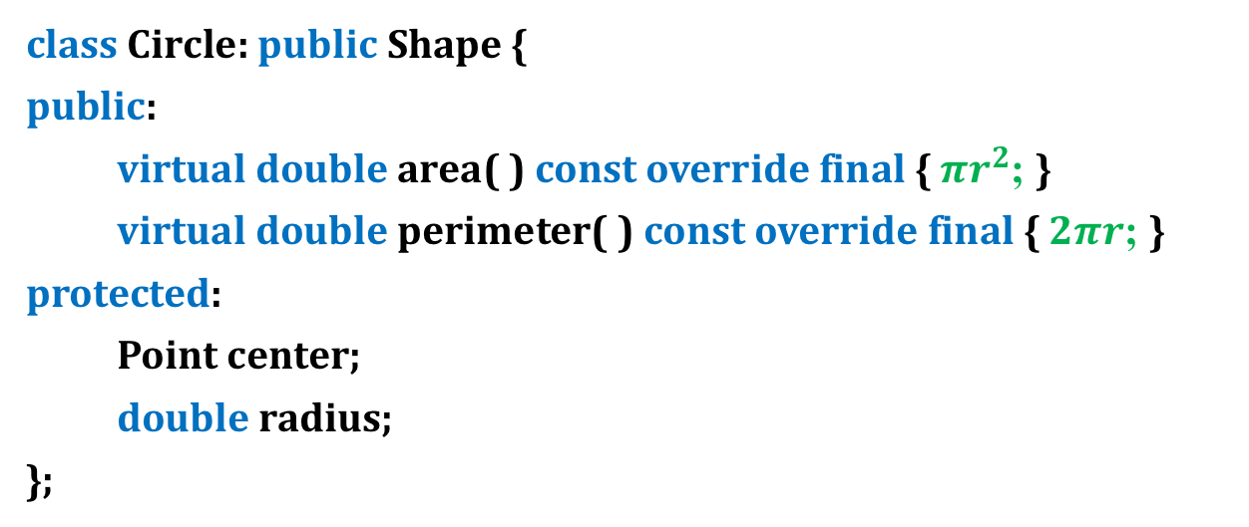
Abstract base classes
class Circle: public Shape {
public:
virtual double area( ) const override final { $πr^{2}$; }
virtual double perimeter( ) const override final { $2πr$; }
protected:
Point center;
double radius;
};

Slide 28
Abstract base classes
void printAreas(const vector<Shape*> &shapes) {
for (const Shape *p: shapes)
cout << p->area( ) << endl;
}
dynamic binding
vector<Shape*> shapes;
shapes.push_back( new Triangle(Point(0, 2), Point(3, 0), Point(-1, -1)) );
shapes.push_back( new EquiTriangle(Point(-1, 0), Point(1, 0), Point(0, sqrt(3))) );
shapes.push_back( new Circle(Point(2, 3), 4.5) );
printAreas(shapes);
5.5
1.73205
63.6173

Slide 29
dynamic_cast
A pointer to the base class cannot automatically be converted to a pointer to a derived class.
Nonetheless, whenever it is necessary, such conversions can be done with dynamic_cast.
vector<Shape*> shapes;
shapes.push_back( new Triangle(Point(0, 2), Point(3, 0), Point(-1, -1)) );
shapes.push_back( new EquiTriangle(Point(-1, 0), Point(1, 0), Point(0, sqrt(3))) );
shapes.push_back( new Circle(Point(2, 3), 4.5) );
Circle *p = dynamic_cast<Circle*>(shapes[2]);
cout << p->getRadius( ) << endl;
4.5
Circle *q = dynamic_cast<Circle*>(shapes[0]);
cout << q->getRadius( ) << endl;
shapes[0]的实际type是Triangle*，不是Circle*，因此dynamic_cast返回nullptr，最后一行代码会有runtime error

Slide 30
Access control
class Quote {
public:
Quote( );
virtual ~Quote( );
private:
string bookNo;
protected:
double price;
};
类的使用者不能从外部直接访问protected成员
派生类的members和friends可以访问基类的protected成员
派生类的members和friends只能通过派生类的对象来访问基类的protected成员
（为什么要有这样的限定？）

Slide 31
Access control
class Quote {
public:
Quote( );
virtual ~Quote( );
private:
string bookNo;
protected:
double price;
};
class DerivedQuote {
public:
DerivedQuote( );
virtual ~DerivedQuote( );
friend double accessPrice(Quote&);
};
不是Quote类的friend，但试图访问（任意）Quote类对象的price
允许这类访问将破坏Quote类的安全性

Slide 32
Multiple inheritance
class Circle: public Shape {
public:
Circle(const Point &p, double r);
virtual ~Circle( );
virtual double area( ) const override final;
virtual double perimeter( ) const override final;
protected:
Point center;
double radius;
};
class Colored {
public:
Colored(const string &c);
virtual ~Colored( );
const string& getColor( ) const;
protected:
string color;
};
Circle
Colored
center: Point
radius: double
- color: string

Slide 33
Multiple inheritance
Shape
class ColoredCircle: public Circle, public Colored {
public:
ColoredCircle(const Point &p, double r, const string &c);
virtual ~ColoredCircle( ) = default;
};
Circle
Colored
- center: Point
- radius: double
- color: string
ColoredCircle
ColoredCircle::ColoredCircle(const Point &p, double r, const string &c):
Circle(p, r), Colored(c) { }
- center: Point
- radius: double
- color: string

Slide 34
Multiple inheritance
Shape
ColoredCircle *cc = new ColoredCircle(Point(0,0), 2.0, “red”);
cout << cc->area( ) << endl;
cout << cc->getColor( ) << endl;
vector<Shape*> shapes;
shapes.push_back(cc);
cout << shapes[0]->area( ) << endl;
ColoredCircle *p = dynamic_cast<ColoredCircle*>(shapes[0]);
cout << p->getColor( ) << endl;
Circle
12.5664
red
Colored
- center: Point
- radius: double
- color: string
ColoredCircle
- center: Point
- radius: double
- color: string
12.5664
red

Slide 35
The diamond problem
Person
- name: string
- ID: string
Student
Teacher
- name: string
- ID: string
- name: string
- ID: string
TA
只需要一组name和ID作为成员变量

Slide 36
The diamond problem
Person
class Person {
protected:
string name;
string ID;
};
- name: string
- ID: string
Student
Teacher
- name: string
- ID: string
- name: string
- ID: string
class Student: virtual public Person { };
class Teacher: virtual public Person { };
class TA: public Student, public Teacher { };
TA

Slide 37
Next lectures (?)
Templates & generic programming (C++ Primer, ch 16)
vector<int> ints;
vector<Shape*> shapes;
template <typename T> void mySort(T *arr, size_t n) { … }
IO library (C++ Primer, ch 8)
fstream, sstream
Reading from / writing to binary files, reinterpret_cast

Slide 38
Next lectures (?)
Common STL containers (C++ Primer ch 9 & 11; cplusplus.com)
vector
list
queue
map
unordered_map
set

